Slide 1
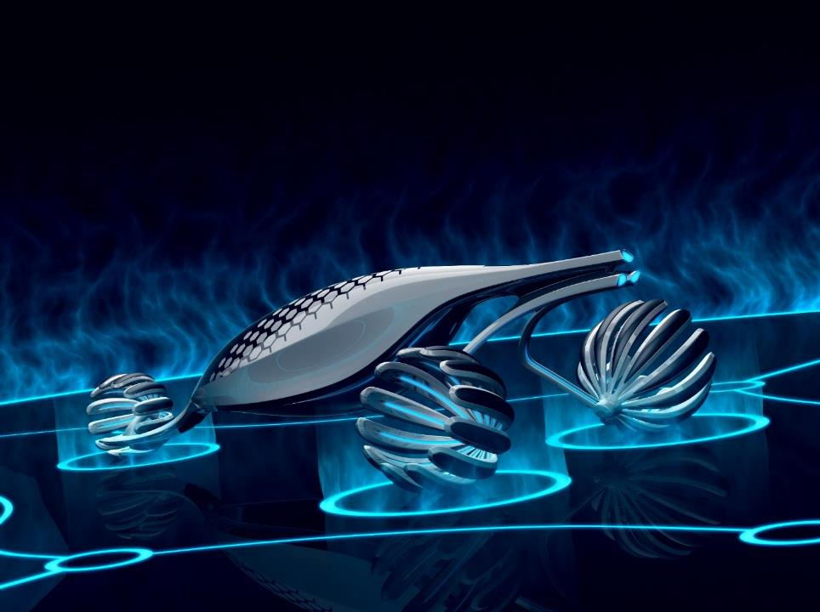
NEXOR IOF consortium
Cyber Physical Systems
Fons De Mey - Research & Innovation Manager
Notes:
Subject
History
Current Structure
Our work
Examples
Valorisation strategy
Challenges

Slide 2
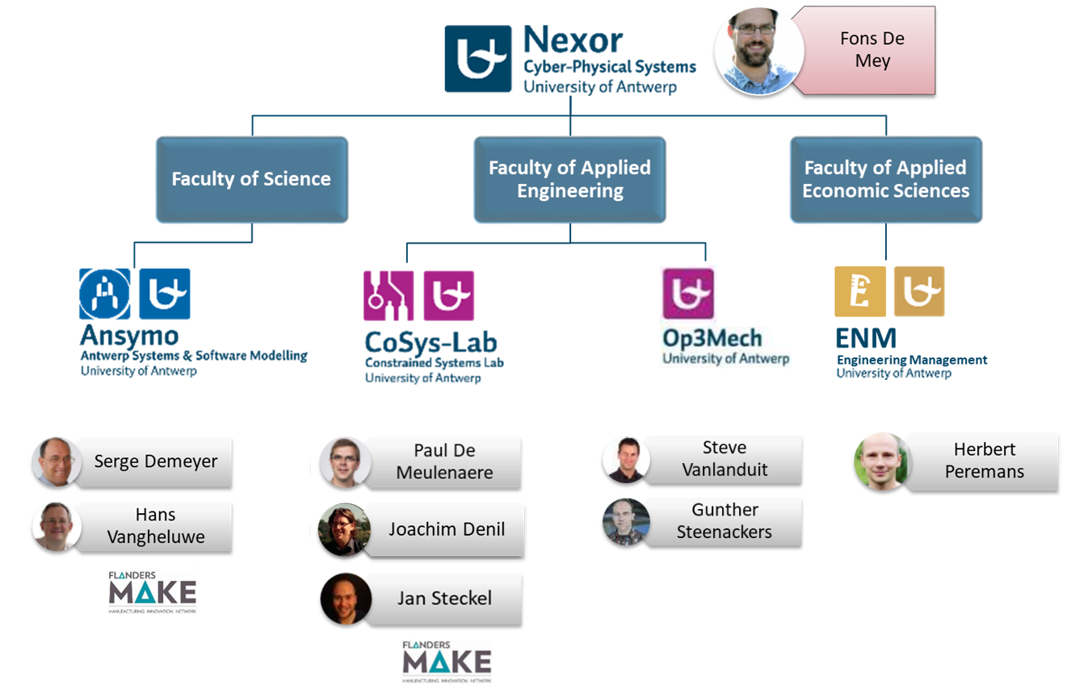
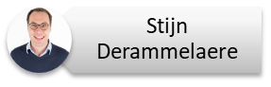
Joachim Denil
Stijn Derammelaere
D&O
D&C

Slide 3
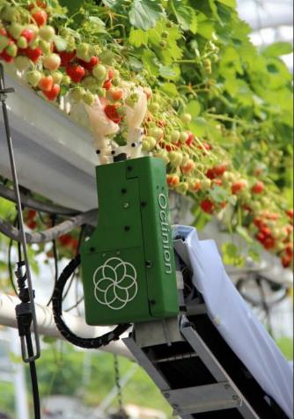
Cyber Physical Systems = High Tech …
Robots
Vehicles
Machines
Manufacturing devices
characterized by
Sensors and actuators
Embedded computer
Physics models
Optimized solutions
(faster, energy efficient, cheaper, lighter, ..)
Radical new solutions
Notes:
NEXOR focusses on Cyber-Physical System ?
What is this ?
Cyber-Physical Systems (CPS) are integrations of computation, networking, and physical processes. Embedded computers and networks monitor and control the physical processes, with feedback loops where physical processes affect computations and vice versa. [http://cyberphysicalsystems.org/]
Cyber
(Embedded) processing
Applied analytics and intelligence
Physical
Interaction with physical world
Based on physical models
Systems
Engineered
Consisting of multiple components
Connected by networks
Integrated approach

Slide 4
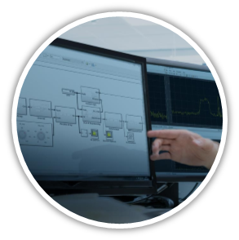
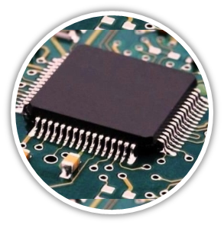

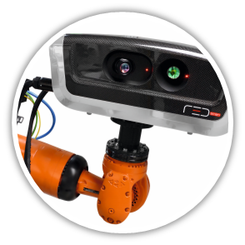
Model-based design and simulations
Embedded systems
NEXOR targets typical questions that arise during industrial design and development of high tech robots, vehicles & machines
Foundations, techniques, methods and tools for the design, analysis, simulation, validation and maintenance of software-intensive and cyber physical systems
Ubiquitous systems, ambient intelligence, embedded systems
Sensing and perception by
autonomous systems
Sensor fusion for optimal
control and non-destructive
testing
Sensors and control
Quality assurance and test automation
Notes:
Unique mix of complementary & interdisciplinary expertise supporting industry partners during
System design
Development
Deployment
Inspection
Operation

Slide 5
Tijdsanalyse voor real-time ingebedde multicoresoftware. | De Meulenaere Paul
subcontracting in Enable S3 | De Meulenaere Paul
Luchtidentificatie-registratie voor cultureel erfgoed: klimaatkwaliteit verbeteren (AIRCHECQ). | Demeyer Serge
Mutaties in software testen: minder, slimmer en sneller (NEXT-O-TEST). | Demeyer Serge
Optimaliseren van continue oplevering voor kleine software bedrijfjes. | Demeyer Serge
Zinvol en schaalbaar hergebruik en compositie van modellen, met "frames". | Denil Joachim
EMPHYSIS - Ingebedde systemen met fysische modellen in de productiecode. | Denil Joachim
Innovatie in het ontwerp van elektronische systemen voor aeronautica | Denil Joachim
3D audio personalisatie voor virtual-reality-toepassingen. | Peremans Herbert
Schaal-vrije passieve akoestische lokalisatie door middel van gesynchroniseerde draadloze sensornetwerken. | Steckel Jan
AirLeakSLAM: on-line detectie van persluchtlekken in industriële omgevingen door combinatie van passieve en actieve ultrasone sensoren. | Steckel Jan
Biologisch geïnspireerde 3D radar sensor voor intelligente robots in complexe omgevingen. | Steckel Jan
Een multi-scale benadering voor het modelleren van vroegtijdige thermo-hydro-mechanischl gedrag van niet-verstevigd beton. | Steenackers Gunther
Snelle breedband lock-in thermografie voor kwetsbare structuren gebruikmakend van systeemidentificatie. | Steenackers Gunther
Slimme integratie van numerieke modellen met thermische inspectie (SINT). | Steenackers Gunther
Ontwikkeling van een nieuwe optische signaalverwerkingmethode om vervormingen in de asfaltconstructie te analyseren met behulp van Fiber Bragg technologie met het oog op het ontwerpen van een nieuw asfaltmodel. | Vanlanduit Steve
3D camera geassisteerde trillingsmetingen voor producttesten en kwaliteitscontrole. | Vanlanduit Steve
Sensing en simulatie voor slimme assemblage en logistiek (SENSALO). | Vanlanduit Steve
Notes:
Timing analysis for real-time embedded multicoresoftware
Multicore processors are increasingly used in mechatronic applications and need to endorse the realtime requirements of the related embedded software. In spite of their huge processing power, certain operational conditions may arise in which they show longer software execution times than reasonably expected. In this project, we will elaborate software timing analysis techniques which will lead to better configurations of multicore platforms with respect to the software execution time and more specifically to the unexpected outliers mentioned above. To this purpose, we will propose a modelling language that will allow for a formal description of the timing properties of real-time embedded multicore software. This modelling language will enable formal methods for schedulability analysis and design space exploration methods, such that timing outliers can be eliminated by suggesting alternative configurations for the multicore platform.
Enable S3
In this project, CoSys-Lab provides support for embedded realisations with AUTOSAR and Hardware-in-the-Loop testing. By means of practical case studies, best practices on the engineering methods and related tooling is collected. The application field is mechatronics and automotive engineering.
Airchecq
Data analytics and grey box modelling for air quality, including a general risk measurement
Next-O-Test
Software-updates are omnipresent in today's digital era and the release cycles within ICT companies are getting faster and faster. Tesla for example loads new software in its cars once every month; Amazon goes even faster and pushes changes to its servers every 12 seconds! With such fast release cycles the need for e_ective quality assurance is rising: software teams must take all possible steps to prevent defects from slipping into production. Today, mutation testing is the state-of-the-art technique to fully automatically assess the fault detection capacity of a software test suite. The approach is too slow for industrial adoption however. Therefore, the NEXT–O–TEST project will investigate three di_erent ways to improve upon the state-of-the-art (fewer, smarter, and faster) to make mutation testing e_ective even in the presence of rapid release cycles. As such, NEXT–O–TEST will allow the NEXOR Consortium to strengthen its expertise on "quality control and test automation" and reinforce its position as a core lab within the Flanders Make research centre.
Optimaliseren continue oplevering
Continuous delivery is the production process currently in use within Facebook and Google, notorious for its ultra-fast yet ultra reliable release cycle. On the surface, continuous delivery is an ideal solution for small technology companies, since it allows them to rapidly respond to specialized needs of demanding customers. However, the particular nature of small software teams raises a few challenges, which we seek to address by advanced tooling infrastructure (i.e. change-based mutation testing, penetration testing).
Frames
Emphysis
Innovatie elektronische systemin voor aeronautica
The INES project, a project consortium with its Flemish component Siemens Industry Software (with its subcontractor Siemens CT) and University of Antwerp, and its Spanish component Boeing Research & Technology Europe (with its subcontractors GMV and Skylife), coordinated through the Eureka program, aims to develop a realistic, innovative and implementable MBSE process as well as identify a series of software tool innovations that cover the complete development and life cycle of avionics systems (understood as the electronic systems of the aircraft including its avionics controller algorithm, software and hardware), which would, within two years, offer an paradigm shift for the development of aircraft electronic systems (avionics), whose objective would be to achieve much higher levels of quality at a reduced development cost with respect to current technology.
3D Audio
Scale-free acoustic localisation
During this project we will develop a framework which allows passive localization of acoustic sources using a synchronized wireless sensor network. Synchronization of the wireless microphone array will be performed using a distributed synchronization scheme absent of a master time representation. The framework will support automatic calibration of the microphone array with minimal human intervention. The location estimate of the acoustic sources will be performed using a probabilistic localization algorithm in combination with known statistics about the behavior of the acoustic source. The framework will be virtually scale-free, which means that the sensor network can be used for tracking a wide variety of acoustic sources in a wide variety of application domains.
AirleakSLAM
3D Radar bioinspired
The goal of this research is to produce a compact, light-weight sensor which will enable an unmanned aerial vehicle to autonomously traverse trajectories through cluttered environments, such as a forest, while sensing and avoiding objects. The sensor is inspired by biological echolocation as performed by bats, which involves emitting an ultrasonic signal and closely listening to its reflections. By analyzing how each received echo differs from the emitted signal and how they mutually vary between its two ears, the bat can determine where the object which reflected the signal is located. Additionally, using sequences of these echoes makes is possible to determine the movement through the environment. We will mimic these features in our system to achieve the same results. For our application we use radio waves (radar) instead of sound (sonar), because these travel at a much greater speeds, while allowing the sensor to operate under circumstances where optical cameras would fail, such as at night, in rain, fog, smoke, etc. Furthermore, we propose a control scheme inspired by cognition, such as insect intelligence, to steer the robot. The idea is to implement a layered system of behavioral units, each with its own goal. Examples of these units include, stopping to avoid a collision, dodging an obstacle, and following a corridor. The system will then execute the behavior with the highest priority which is active at each given moment, creating an overall emergent intelligence.
Multi-scale vroegtijdig thermo-hydro-mechanisch gedrag van beton
The integrity of non-reinforced concrete structures at early stages of construction depends on many factors. One of these is the formation of cracks, which may be crucial in some applications. This problem is of great relevance for deep geological disposal concepts which consider concrete as one of the principle engineered barrier components, and for which the expected service life is > 1000s of years. This is particularly the case within the current Belgian disposal concept in which heat emitting radioactive wastes are post-conditioned in concrete/steel containers, to be placed in a deep underground geological formation using a system of galleries supported by non-reinforced concrete lining. In the early stages of repository construction and waste emplacement, the mechanical integrity of the concrete components is of utmost importance from the point of view of safety and performance. The potential retrievability/reversibility of wastes within a prolonged time period after waste emplacement places additional performance requirements on these concrete structures, which must retain their structural integrity over this period. The principal objective of this PhD is to make a first attempt at developing and implementing a multiscale-based coupled thermo-hydro-mechanical model to study the early age behaviour of nonreinforced concrete. In particular, the PhD student will develop a mathematical model that captures cracking potential due to thermo-hydraulic-mechanical transient conditions. To a limited extent, a secondary objective is also envisaged in which small laboratory-scale experiments may be carried out to derive parameters of importance for the multiscale models as well as for validation purposes.
Thermografie fvoor kwetsbare structuren
In this project a new methodology for product testing and quality control is developed based on infrared lock-in thermography. Infrared thermography permits to visualize the thermal/ warmup response of objects. In particular, lock-in thermography employs a sinusoidal light source to warm up the object being studied. Although pulsed thermography (PT) is commonly used as thermographic inspection technique, this method is not well suited for inspection of fragile structures (art and biological tissue inspection, blood circulation, …) due to the large instant energy emission which involves insufficient controllability and non-uniformity. On the other hand, with traditional lock-in thermography only one defect depth can be inspected at a time. In addition, at least one steady state period of the sine wave excitation is necessary to obtain quantitative results.
SINT
Combining finite element models with non-destructive testing has enormous potential for valorization. The objective of this project is to develop a reliable damage detection and localization tool by combining NDT thermography data with FE modeling, making use of system identification. As the amount of experimental data is very high and depending on the resolution of the IR camera, the goal is to use virtual modeling in assistance of the NDT tests in order to gain accuracy and time-efficiency.
Signal Processing for Fiber Bragg technologie
This project focuses on collecting and verifying reliable deformation data of asphalt pavements by using Fiber Bragg Grating sensors. FBG is a new technology for measuring deformations in a material, e.g. by external loading. The FBG technology could give a solution to measure these deformations continuously for a lower cost. Moreover, FBG will give more insight in the deformation under all available conditions (temperature of the road, different loadings, rest periods). The first workpackage focuses on the signal processing of optical FBG spectra i.e. how to determine the peak shifts in order to obtain a correct strain value. workpackage 2 focuses on the identification of the Young modulus from FBG vibration measurements using the so-called inverse modelling approach to identify the mechanical material properties of the different layers of the asphalt, starting from a simple elastic Young's modulus model. Workpackage 3 deals with the monitoring of the Young modulus in time on the asphalt pavement structure of CyPaTs bicycle path during 24 months, and relating these to more complex models.
3d camera assisted vibration measurements
In this project we will develop a technique that combines information from 3D time-of-flight camera's and computer-aided-design drawings of a product in order to facilitate product testing and quality control. The proposed procedure firstly allows the test engineer to automatically determine the sensor positions on a product. Secondly, we develop a methodology to perform vibration measurements on moving components (wind turbines, wind screen wipers, etc. or products on a conveyor belt).
Sensalo
In the project we use 3D vision techniques in order to make the assembly process more efficient and safer. This is done by tracking people, products and machines (like cobots) in a manufacturing environment.

